Slide 1
Data Structures and Algorithms -3 (25CS2103E)
PROPERTY FINDER
Team Members
Yashwanth - 2520030259
Bharath - 2520030169
Praneeth -2520030186
Under the Esteemed Guidance of
DR.V.Sireesha

Slide 2
Contents
Abstract
Introduction
Literature survey
Problem Statement and Objectives
Hardware and Software requirements
Results
Conclusion
Future Scope

Slide 3
Abstract
The Property Finder System is a Java-based application designed to help users search and filter real-estate properties efficiently. It allows users to search based on location, budget, property type, bedrooms, and amenities.
The system applies Data Structures and Algorithms such as KMP string matching, graphs, hashing, sorting, and dynamic programming to improve searching, filtering, ranking, and recommendations.

Slide 4
Introduction
Finding a suitable property from thousands of available listings can be difficult and time-consuming. The proposed Property Finder System provides an efficient way to search and compare properties according to user requirements.
The project focuses on applying Advanced DSA concepts in Java to solve a real-world property-search problem.

Slide 5
Literature Survey
Existing real-estate platforms provide property search and filtering features, but searching through a large number of listings can still be challenging.
Our proposed system focuses on improving the search process using KMP/Z string matching, HashMap, sorting, graph algorithms, and recommendation techniques.

Slide 6
Problem Statement and Objectives
Problem Statement:
Large number of property listings
Difficult to find suitable properties quickly
Traditional searching can become inefficient with large data
Limited optimized recommendations
Objectives:
Provide fast property searching
Apply multiple filters efficiently
Rank and recommend suitable properties
Find nearby facilities using graphs
Efficiently manage property data

Slide 7
Flow Chart

Slide 8
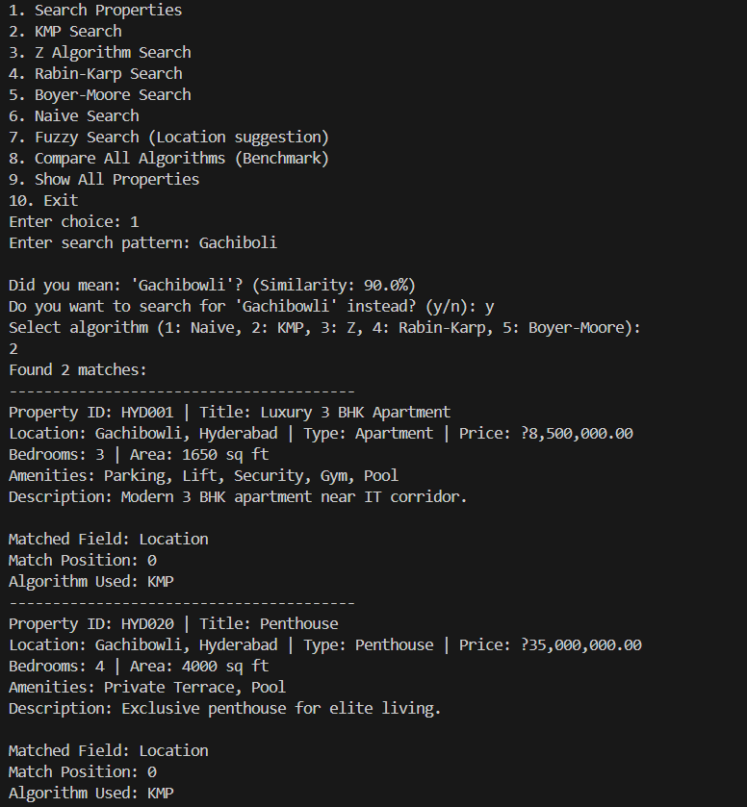
Results

Slide 9
Hardware and Software requirements
Hardware:
Computer/Laptop
Minimum 4 GB RAM
Minimum 10 GB free storage
Internet connection for database/setup if required
Software:
Java
File Handling
Git & GitHub (optional)

Slide 10
Conclusion
The Property Finder System demonstrates how Advanced Data Structures and Algorithms can be applied to a real-world real-estate problem. The combination of Java, MySQL, and DSA techniques provides an efficient approach to property searching, filtering, ranking, and recommendation.

Slide 11
Future Scope
Add AI-based property recommendations
Add map and location integration
Add property price prediction
Add advanced text search
Add property risk/document verification indicators
Include Hyderabad-specific location and property information
Develop a mobile application
Add real-time property availability and updates

Slide 12
Thank you

